Slide 1

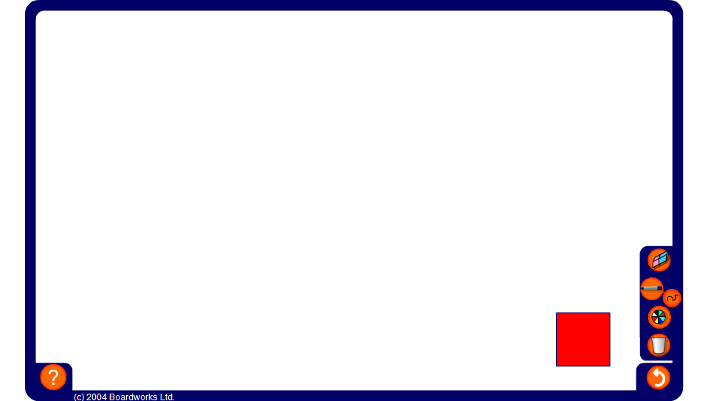


Making squares
Notes:
Ask volunteers to come to the board and arrange 9 tiles to make a square.
Tell pupils that the number 9 is called a square number.
Can we arrange 16 tiles to make a square?
Ask a volunteer to demonstrate this and ask pupils to tell you how we can decide whether or not 16 is a square number. Establish that to make a square we need the same number of rows and columns. We can arrange 16 tiles in 4 rows and 4 columns and so it is a square number. We can make a square number by multiplying a whole number by itself.
Can we arrange 20 tiles to make a square?
What is the next square number? (25)
What is the smallest square number? (1)
Tell pupils that when we multiply a number by itself, for example 6 × 6, it is called squaring the number and that another way of saying 6 × 6 is ‘six squared’. The result, for example, 36, is called a square number.

